Slide 1
Final Project Integration: Wall Following and AEB
Ben Stone

Slide 2
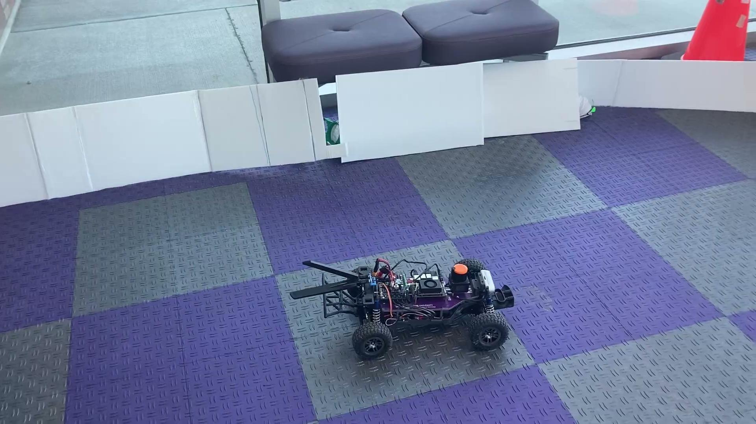
Wall Following

Slide 3
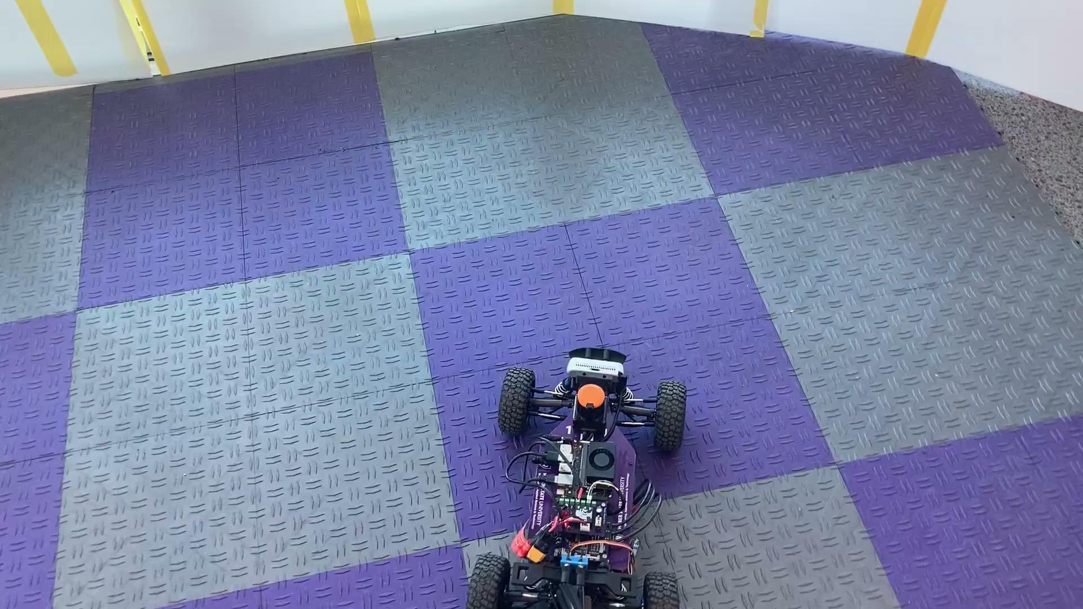
Automatic Emergency Braking (AEB)

Slide 4
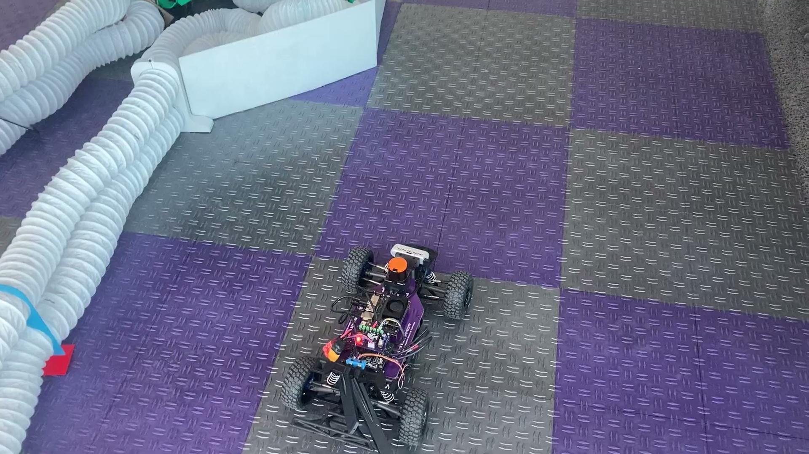
Integration

